Slide 1







Stack Overflow Developer Survey
Gabriella Dudás
May 2024
Notes:
The title slide contains all details

Slide 2



OUTLINE
Executive Summary
Introduction
Methodology
Results
Programming Language Trends
Database Trends
Dashboard
Discussion about Job Satisfaction
Findings & Implications
Conclusion
Appendix
Notes:
Has the learner included additional value in any way into this presentation?
Has the learner used creativity to make the presentation look better?
Has the learner included additional value in any way into this presentation?

Slide 3

EXECUTIVE SUMMARY
Stack Overflow surveyed the developer community to gain insight into the following main topics:
Most widely used technologies currently and in the foreseeable future based on the preferences of the respondents
Who are making up the developer community – geographic locations, education level, age and gender of the participating developers and their career satisfaction level
How much do the participants benefit from the usage of Stack Overflow
Notes:
The executive summary Slide contains at least four valid bullet points.

Slide 4

INTRODUCTION
The survey was designed to
identify trends in technologies,
provide insight about the developer community Stack Overflow serves and
assess how much Stack Overflow has been contributing to the productivity of the community
The findings, on one hand, are supposed to provide guidance to those looking for directions for their technology investment plans or in their learning journey
On the other hand, the Stack Overflow Service Team will utilize the feedbacks to improve the user experience
Notes:
The introduction slide has the details like, what is this report about, who is the report for, and what will a reader gain by reading through this report

Slide 5

METHODOLOGY
Online survey was conducted between 23rd January and 14th February 2019
Respondents were recruited primarily through channels owned by Stack Overflow
Main focus areas of the questions were:
Technology
Career (including salary, experience, satisfaction)
Demographics
The survey took around 20 minutes to fill on average
The anonymized results of the survey were made available publicly
Notes:
The Methodology slide talks about data collection methods and data sources

Slide 6
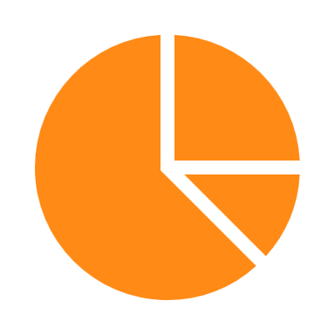
RESULTS

Slide 7
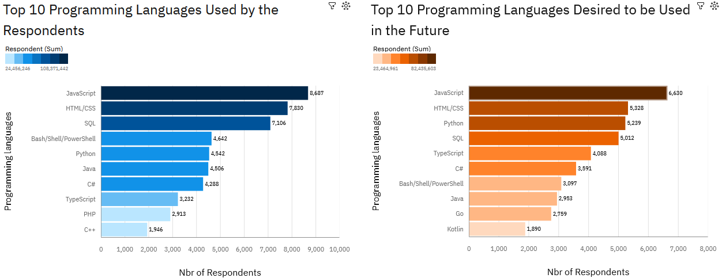
PROGRAMMING LANGUAGE TRENDS
Notes:
The slide Programming Languages Trends contains both the bar charts for the current year and future year and the charts have proper label and title, and are sorted in descending order.

Slide 8
PROGRAMMING LANGUAGE TRENDS - FINDINGS & IMPLICATIONS
Findings
JavaScript is the most commonly used language and in the same time attracts the most interest
HTML and SQL have their strong presence behind JavaScript
Python has beaten Java and C# in rank and places as the 3rd on the learning plans of the community
Scripting languages solidly among the top 10
Implications
JavaScript seems to stick around for a while to lead the development work
HTML and SQL with their own special use cases are still major players on the skill market
The Python community shows the most dynamic growth among all
The knowledge of scripting languages is still a must and seems like this won’t change in the near future
Notes:
The Programming Languages Trends - Findings and Implications slide contains at least four findings and implications

Slide 9
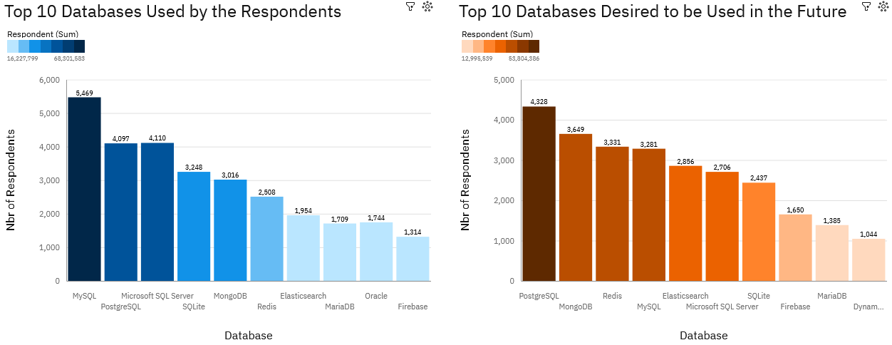
DATABASE TRENDS
Notes:
The slide Database Trends contains both the bar charts for current year and future year and the charts have proper label and title, and are sorted in descending order.

Slide 10
DATABASE TRENDS - FINDINGS & IMPLICATIONS
Findings
MySQL leads today, but PostgreSQL has the ambition to soon take over the lead
The top 4 databases are all SQL based ones, but the community shows more and more interest towards MongoDB and Redis
Oracle is still here, but how long?
Implications
People’s preference is shifting towards open-source technologies
Databases able to handle non-structured and big data are gaining significant market share
Looks like the world is passing by Oracle
Notes:
The Database Trends - Findings and Implications slide contains at least four findings and implications

Slide 11

DASHBOARD
https://github.com/gabriella-dudas/Learning/blob/main/Capstone%20Project%20Final%20Assignment%20Dashboard.pdf
Notes:
The Dashboard section has a link to Cognos and the link is working, and contains screen shots of 3 tabs.

Slide 12
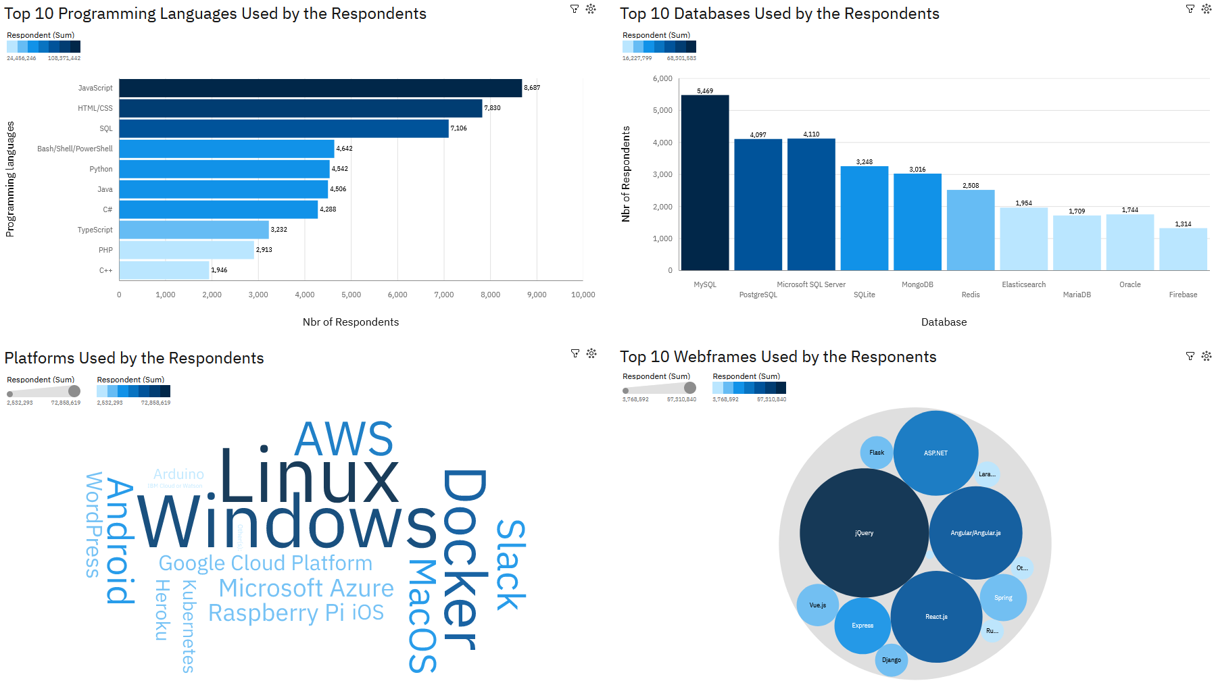
CURRENT TECHNOLOGY USAGE
Notes:
The overall findings and implications slide contains at least four findings and implications

Slide 13
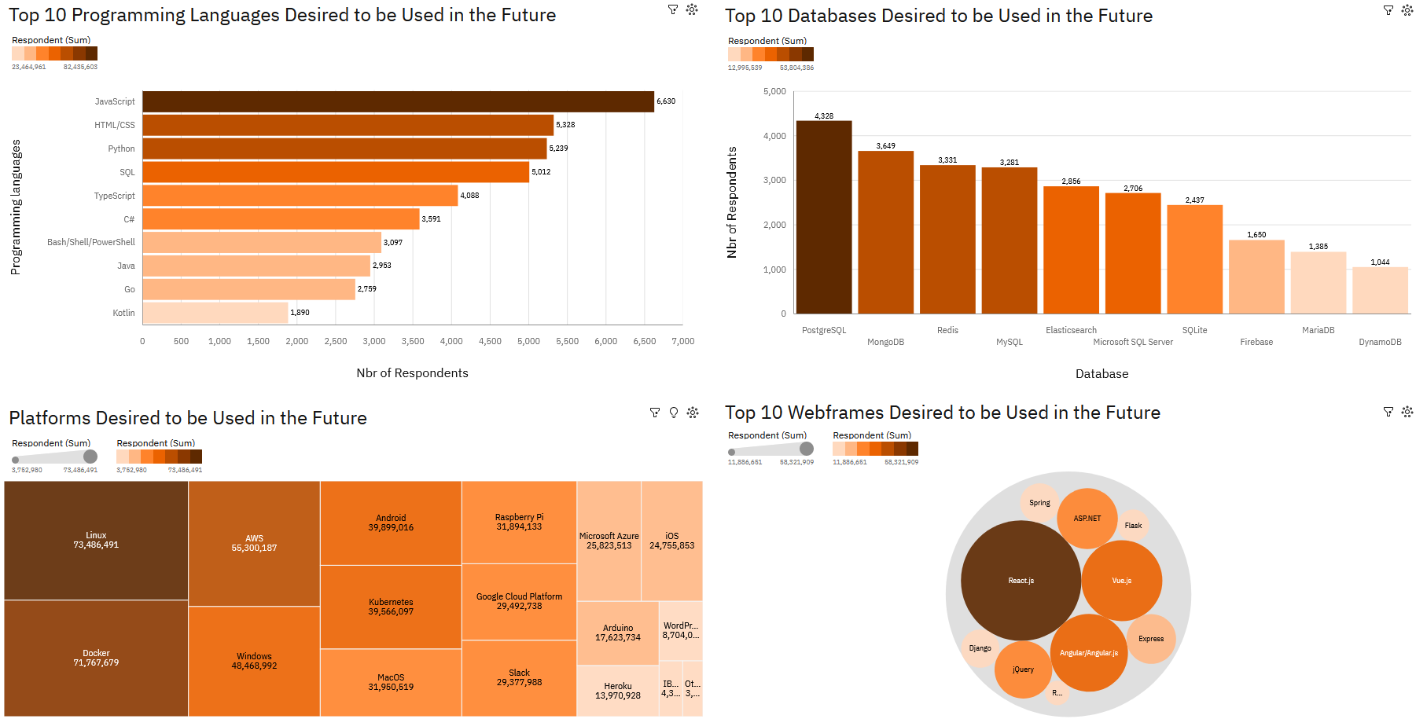
FUTURE TECHNOLOGY TREND

Slide 14
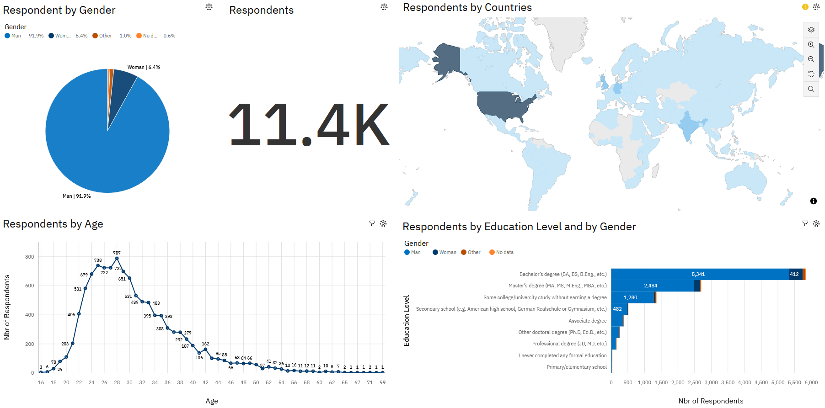
DEMOGRAPHICS

Slide 15

DISCUSSION

Slide 16
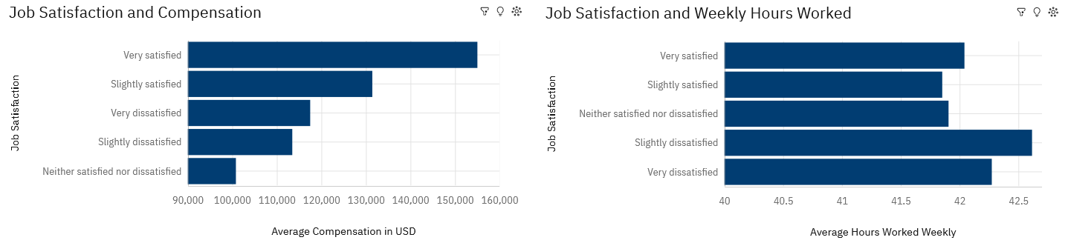
Job Satisfaction (2/1)
No surprise: job satisfaction increases with earned compensation and drops with more hours worked, although even those very satisfied with their job are working around 42 hours per week on average.

Slide 17
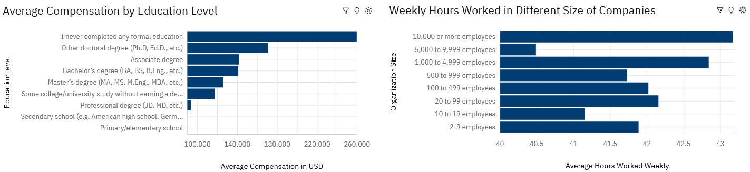
Job Satisfaction (2/2)
Compensation is mostly not tied to education, but hours worked seems to be the higher the size of the employer’s organization.

Slide 18
OVERALL FINDINGS & IMPLICATIONS
Findings
Vast majority of the developer community is of Millennials and Gen Z
Job satisfaction is clearly tied to compensation and total working hours
The highest average compensation is of those without formal educational degree
The developer profession seem to attract more man, than woman
Implications
The developer community is full of young energy
Big corps need to balance workload and compensation to keep their talents on board
Educational institutes doesn’t seem to be able to keep up with the rapidly changing technologies
On the job experience still outweighs formal degrees in the race for better salaries
Notes:
The overall findings and implications slide contains at least four findings and implications

Slide 19

CONCLUSION
The future of SW development relies on open-source technologies
Big and unstructured data are getting utilized more and more
Professional success follows organic knowledge gained through experience
JavaScript, HTML, SQL and Python are the most trending programming languages among users, however there’s a shortage of C and C++ skills on the job market
Notes:
Conclusion Slide contains at least four valid bullet points.

Slide 20

APPENDIX
Further data was collected from GitHub job postings through webscraping to observe the trending technologies on the job market
The programming language skills most employers are looking for are mainly C, C++ followed by Java and Python
The highest average salaries are offered to those with knowledge of Swift, followed by Python, C++ and JavaScript

Slide 21
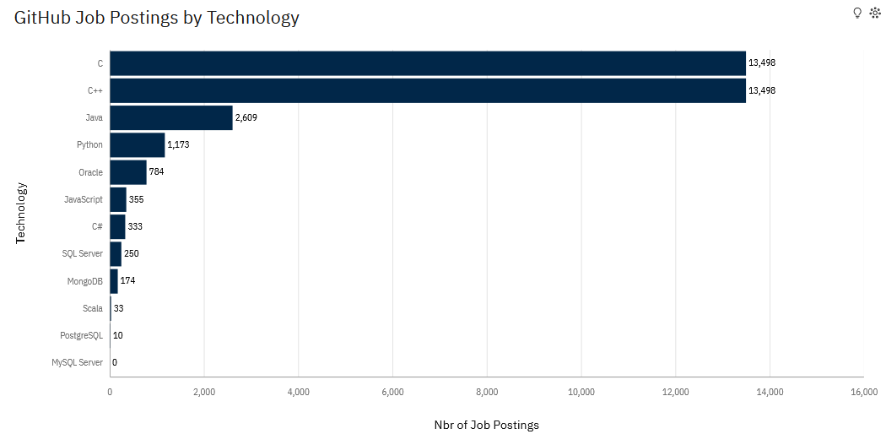
JOB POSTINGS
Notes:
Appendix section contains bar chart of Git Hub Jobs data, with proper title and labels, and the data is in descending order.

Slide 22
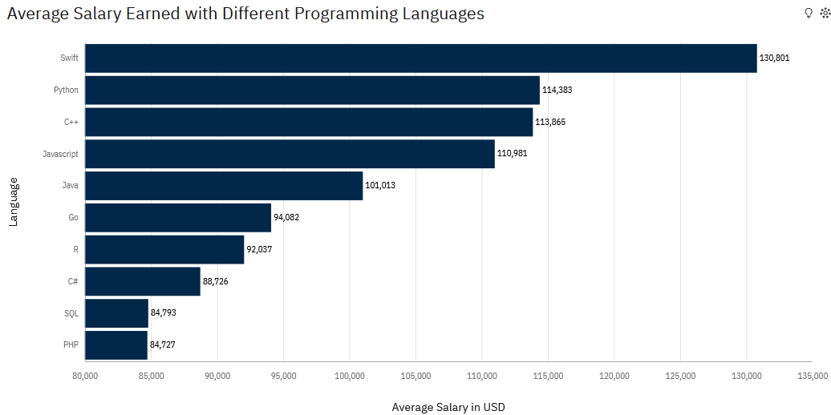
POPULAR LANGUAGES
Notes:
Appendix section contains bar chart of popular languages data, with proper title and labels, and the data is in descending order.

Slide 23

MORE ABOUT THE SURVEY
https://insights.stackoverflow.com/survey/2019?utm_source=so-owned&utm_medium=blog&utm_campaign=dev-survey-2019&utm_content=launch-blog#overview

